Slide 1
Chapter 10: File-System Interface

Slide 2
Chapter 10: File-System Interface
File Concept
Access Methods
Directory Structure
File-System Mounting
File Sharing
Protection

Slide 3
Objectives
To explain the function of file systems
To describe the interfaces to file systems
To discuss file-system design tradeoffs, including access methods, file sharing, file locking, and directory structures
To explore file-system protection

Slide 4
File Concept
Contiguous logical address space
File is a named collection of related information that is recorded on secondary storage.
File has a certain defined structure, which depends on its type.
A text file is a sequence of characters organized into lines.
A source file is a sequence of subroutines and functions, further organized as declarations followed by executable statements.
Object file is a sequence of bytes organized into blocks understandable by system’s linker.
An executable file is a series of code sections that the loader can bring into memory and execute.

Slide 5
File Structure
None - sequence of words, bytes
Simple record structure
Lines
Fixed length
Variable length
Complex Structures
Formatted document
Relocatable load file
Can simulate last two with first method by inserting appropriate control characters
Who decides:
Operating system
Program

Slide 6
File Attributes
Name – only information kept in human-readable form
Identifier – unique tag (number) identifies file within file system
Type – needed for systems that support different types
Location – pointer to file location on device
Size – current file size
Protection – controls who can do reading, writing, executing
Time, date, and user identification – data for protection, security, and usage monitoring
Information about files are kept in the directory structure, which is maintained on the disk

Slide 7
File Operations
File is an abstract data type
Create
Write
Read
Reposition within file
Delete
Truncate
Open(F_{i}) – search the directory structure on disk for entry F_{i}, and move the content of entry to memory
Close (F_{i}) – move the content of entry F_{i} in memory to directory structure on disk

Slide 8
Open Files
Several pieces of data are needed to manage open files:
File pointer: pointer to last read/write location, per process that has the file open
File-open count: counter of number of times a file is open – to allow removal of data from open-file table when last processes closes it
Disk location of the file: cache of data access information
Access rights: per-process access mode information

Slide 9
Open File Locking
Provided by some operating systems and file systems
Mediates access to a file
Shared or exclusive locks.
Mandatory or advisory:
Mandatory – access is denied depending on locks held and requested
Advisory – processes can find status of locks and decide what to do

Slide 10
File Locking Example – Java API
import java.io.*;
import java.nio.channels.*;
public class LockingExample {
public static final boolean EXCLUSIVE = false;
public static final boolean SHARED = true;
public static void main(String arsg[]) throws IOException {
FileLock sharedLock = null;
FileLock exclusiveLock = null;
try {
RandomAccessFile raf = new RandomAccessFile("file.txt", "rw");
// get the channel for the file
FileChannel ch = raf.getChannel();
// this locks the first half of the file - exclusive
exclusiveLock = ch.lock(0, raf.length()/2, EXCLUSIVE);
/** Now modify the data . . . */
// release the lock
exclusiveLock.release();

Slide 11
File Locking Example – Java API (Cont.)
// this locks the second half of the file - shared
sharedLock = ch.lock(raf.length()/2+1, raf.length(), SHARED);
/** Now read the data . . . */
// release the lock
sharedLock.release();
} catch (java.io.IOException ioe) {
System.err.println(ioe);
}finally {
if (exclusiveLock != null)
exclusiveLock.release();
if (sharedLock != null)
sharedLock.release();
}
}
}

Slide 12
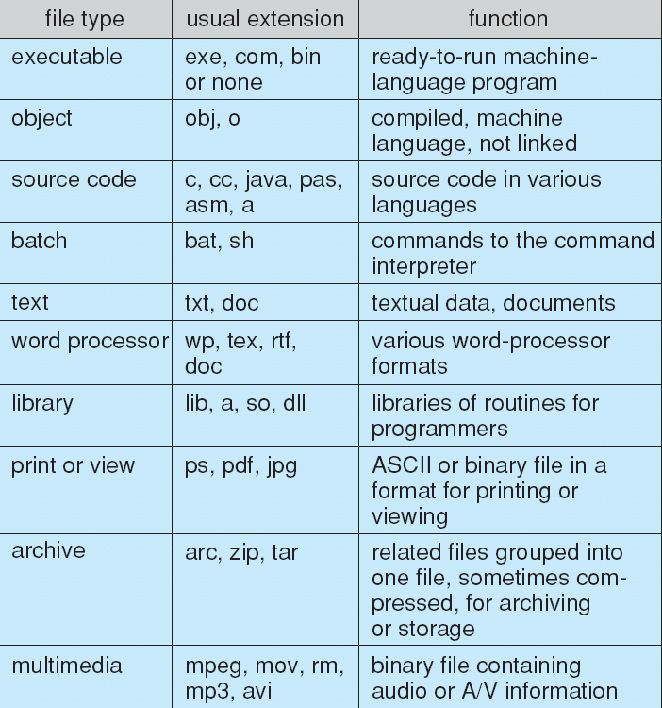
File Types – Name, Extension

Slide 13
File structure
File types can be used to indicate the internal structure of the file.
The OS requires that an executable file have a specific structure so that it can determine where in memory to load the file and what the location of the first instruction is.
This idea is extended in some OS to have system supported file structures, with set of special operations for manipulating files with those structures.
This is disadv. Since then OS needs to support multiple file structures, making the system cumbersome.
Some OS impose a minimal number of file structures.
Machintosh OS supports a minimal number of file structures. It expects files to contain two parts: a resource fork and data fork.
Resource fork contains information of interest to the user eg. Language.etc (labels of buttons to be modified ,etc)
Data fork contains program code or data- traditional file contents.

Slide 14
Internal file structure
Internally locating an offset within a file can be complicated for OS.
Disk systems typically have a well defined block size determined by the size of sector
All disk I/O is performed in units of one block and all blocks are of same size.
Unlikely that physical record size will exactly match the length of the desired logical record. Logical records may even vary in length.
Packing a number of logical records into physical blocks is a common solution for this problem.
Since disk space is always allocated in blocks, some portion of the last block of each file is generally wasted.
This waste in terms of units of blocks is internal fragmentation.

Slide 15
Access Methods
Sequential Access
read next
write next
reset
no read after last write
(rewrite)
Direct Access
read n
write n
position to n
read next
write next
rewrite n
n = relative block number

Slide 16
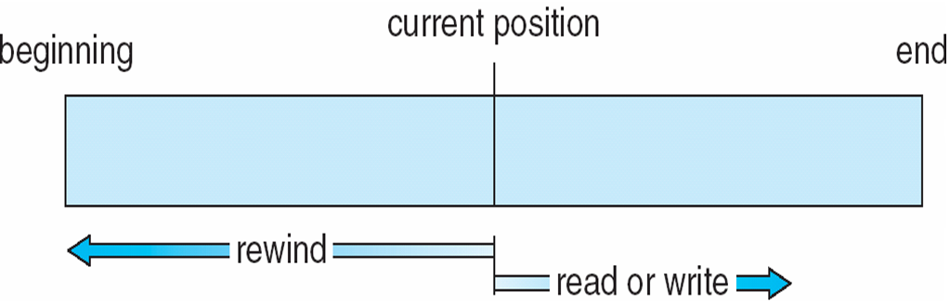
Sequential-access File

Slide 17
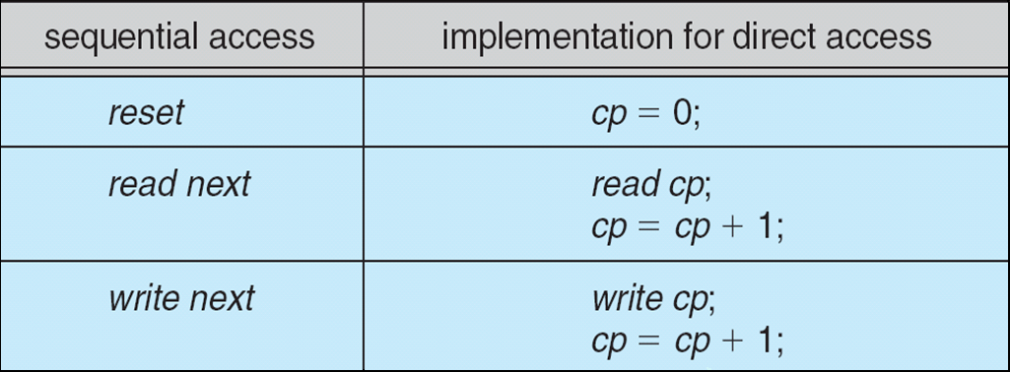
Simulation of Sequential Access on Direct-access File

Slide 18
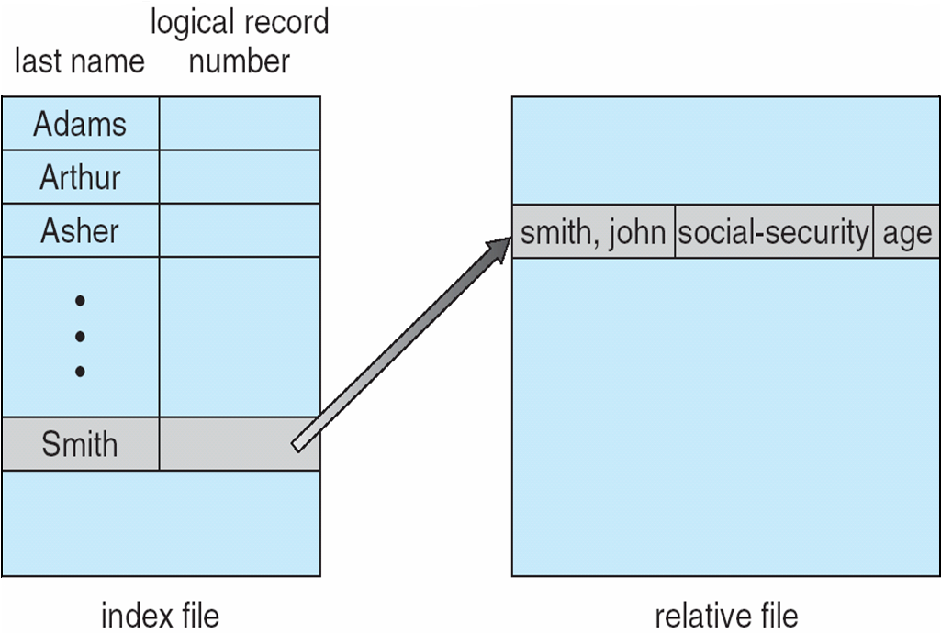
Example of Index and Relative Files

Slide 19
Directory Structure
A collection of nodes containing information about all files
Directory
Files
F 1
F 2
F 3
F 4
F n
Both the directory structure and the files reside on disk
Backups of these two structures are kept on tapes

Slide 20
Disk Structure
Disk can be subdivided into partitions
Disks or partitions can be RAID protected against failure
Disk or partition can be used raw – without a file system, or formatted with a file system
Partitions also known as minidisks, slices
Entity containing file system known as a volume
Each volume containing file system also tracks that file system’s info in device directory or volume table of contents
As well as general-purpose file systems there are many special-purpose file systems, frequently all within the same operating system or computer

Slide 21
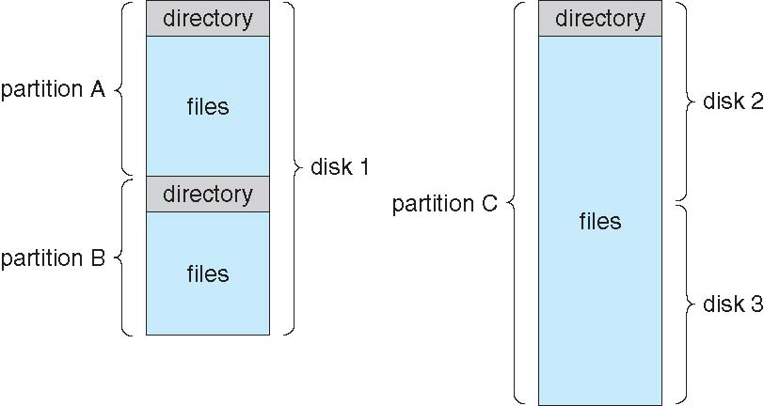
A Typical File-system Organization

Slide 22
Operations Performed on Directory
Search for a file
Create a file
Delete a file
List a directory
Rename a file
Traverse the file system

Slide 23
Organize the Directory (Logically) to Obtain
Efficiency – locating a file quickly
Naming – convenient to users
Two users can have same name for different files
The same file can have several different names
Grouping – logical grouping of files by properties, (e.g., all Java programs, all games, …)

Slide 24
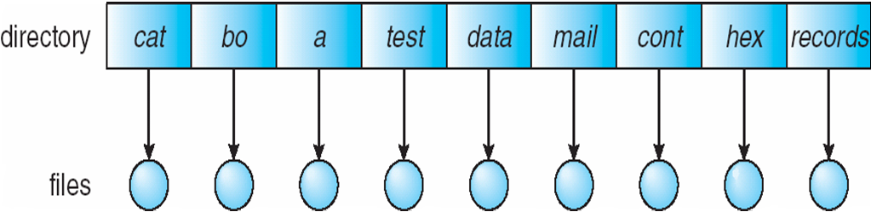
Single-Level Directory
A single directory for all users
Naming problem
Grouping problem

Slide 25
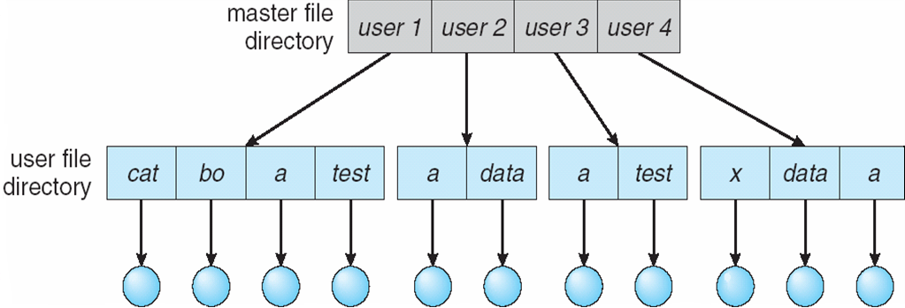
Two-Level Directory
Separate directory for each user
UFD and MFD
Path name(user name, file name)
Can have the same file name for different user
Efficient searching
No grouping capability. No cooperation since structure is isolated.

Slide 26
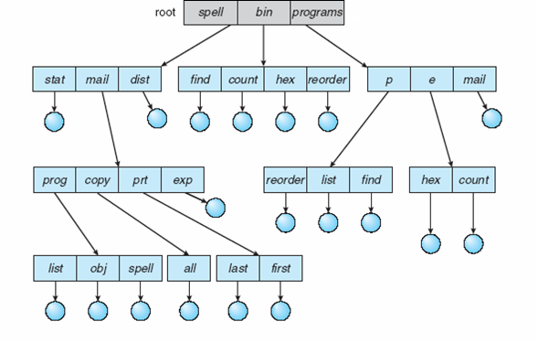
Tree-Structured Directories

Slide 27
Tree-Structured Directories (Cont.)
Efficient searching
Grouping Capability
Current directory (working directory)

Slide 28
Tree-Structured Directories (Cont)
Absolute (from root) or relative path name(starts from current)
Creating a new file is done in current directory
Delete a file
rm <file-name>
Creating a new subdirectory is done in current directory
mkdir <dir-name>
Example: if in current directory /mail
mkdir count
mail
prog
copy
prt
exp
count
Deleting “mail” ⇒ deleting the entire subtree rooted by “mail”

Slide 29
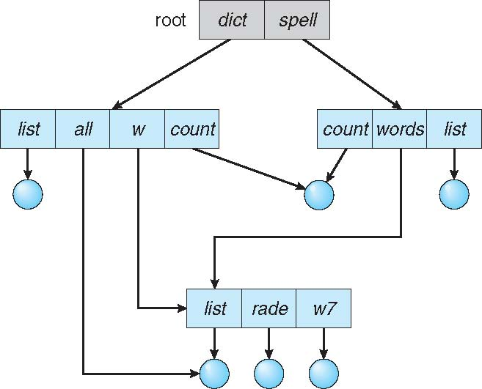
Acyclic-Graph Directories
Have shared subdirectories and files

Slide 30
Acyclic-Graph Directories (Cont.)
Two different names (aliasing). With two copies changes in one not reflected in another. Only if shared copy then changes are reflected.
If dict deletes list ⇒ dangling pointer
Solutions:
Backpointers, so we can delete all pointers Variable size records a problem (searching for all pointers is expensive)
Backpointers using a daisy chain organization(search the pointer when required)
Entry-hold-count solution
New directory entry type
Link – another name (pointer) to an existing file
Resolve the link – follow pointer to locate the file

Slide 31
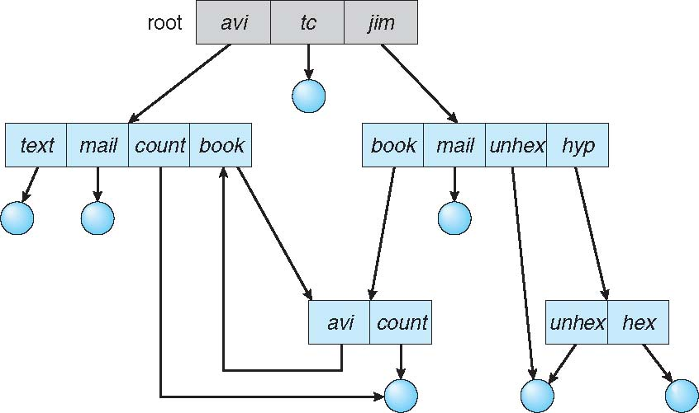
General Graph Directory

Slide 32
General Graph Directory (Cont.)
How do we guarantee no cycles? (count may not be zero in case of cycles)
Allow only links to file not subdirectories
Garbage collection( to check if the last reference has been deleted and if the space of disk has been allocated or not)
Every time a new link is added use a cycle detection algorithm to determine whether it is OK

Slide 33
File System Mounting
A file system must be mounted before it can be accessed
A unmounted file system (i.e., Fig. 11-11(b)) is mounted at a mount point
The OS is given the name of the device and the mount point i.e. the location within the file structure where the file system is to be attached)
The OS verifies the device contains a valid file system by asking the device driver to read the device directory and verifying that the directory has the expected format.
Finally the OS notes in its directory structure that a file system is mounted at the specified mount point.
This scheme enables the OS to traverse its directory structure switching among the file systems.

Slide 34
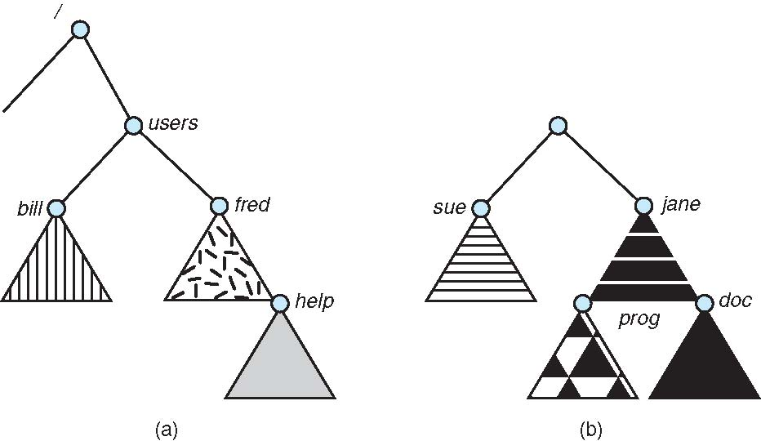
(a) Existing (b) Unmounted Partition

Slide 35
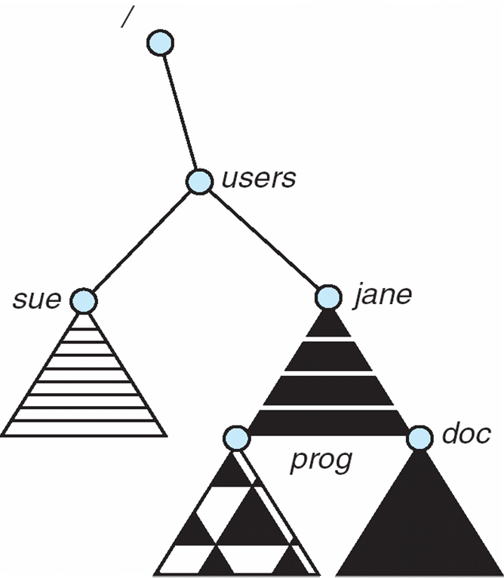
Mount Point

Slide 36
File Sharing
Sharing of files on multi-user systems is desirable
Sharing may be done through a protection scheme
On distributed systems, files may be shared across a network
Network File System (NFS) is a common distributed file-sharing method

Slide 37
File Sharing – Multiple Users
User IDs identify users, allowing permissions and protections to be per-user
Group IDs allow users to be in groups, permitting group access rights

Slide 38
File Sharing – Remote File Systems
Uses networking to allow file system access between systems
Manually via programs like FTP
Automatically, seamlessly using distributed file systems
Semi automatically via the world wide web
Client-server model allows clients to mount remote file systems from servers
Server can serve multiple clients
Client and user-on-client identification is insecure or complicated
NFS is standard UNIX client-server file sharing protocol
CIFS is standard Windows protocol
Standard operating system file calls are translated into remote calls
Distributed Information Systems (distributed naming services) such as LDAP, DNS, NIS, Active Directory implement unified access to information needed for remote computing

Slide 39
File Sharing – Failure Modes
Remote file systems add new failure modes, due to network failure, server failure
Recovery from failure can involve state information about status of each remote request
Stateless protocols such as NFS include all information in each request, allowing easy recovery but less security

Slide 40
File Sharing – Consistency Semantics
Consistency semantics specify how multiple users are to access a shared file simultaneously
Similar to process synchronization algorithms
Tend to be less complex due to disk I/O and network latency (for remote file systems
Andrew File System (AFS) implemented complex remote file sharing semantics
Unix file system (UFS) implements:
Writes to an open file visible immediately to other users of the same open file
Sharing file pointer to allow multiple users to read and write concurrently
AFS has session semantics
Writes only visible to sessions starting after the file is closed

Slide 41
Protection
File owner/creator should be able to control:
what can be done
by whom
Types of access
Read
Write
Execute
Append
Delete
List

Slide 42
Access Lists and Groups
Mode of access: read, write, execute
Three classes of users
RWX
a) owner access 7 ⇒ 1 1 1 RWX
b) group access 6 ⇒ 1 1 0
RWX
c) public access 1 ⇒ 0 0 1
Ask manager to create a group (unique name), say G, and add some users to the group.
For a particular file (say game) or subdirectory, define an appropriate access.
owner
group
public
chmod
761
game
Attach a group to a file chgrp G game

Slide 43
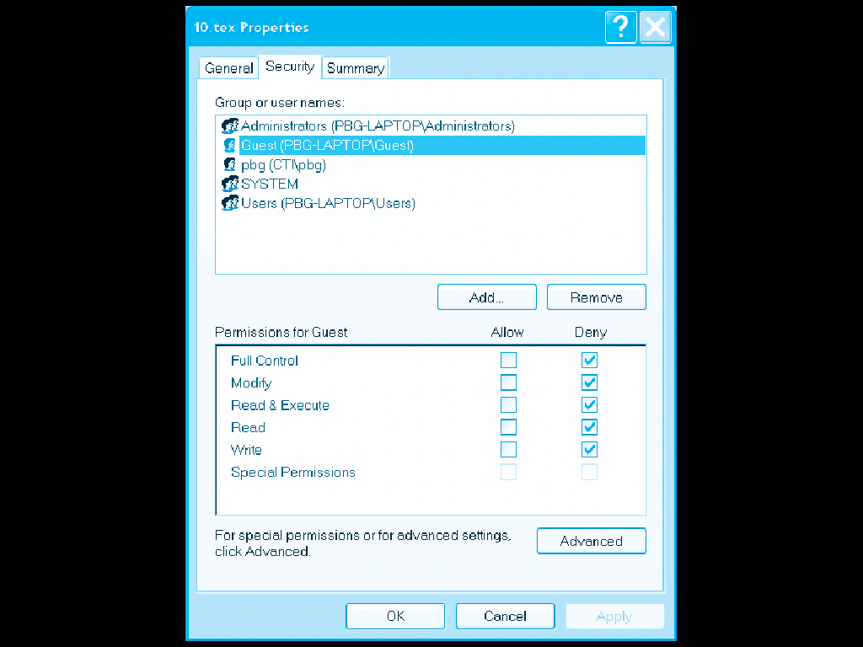
Windows XP Access-Control List Management

Slide 44
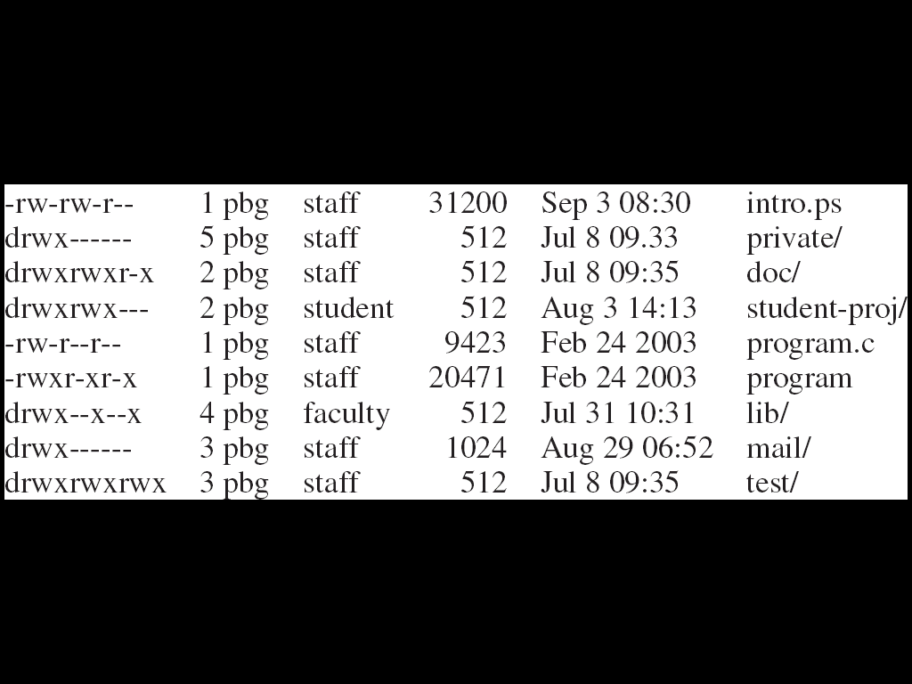
A Sample UNIX Directory Listing

Slide 45
End of Chapter 10

